Slide 1
Local Government
Local Government: Municipalities, Counties, Townships, New England Towns and Special Districts
Copyright @ 2011, 2009, 2007 Pearson Education, Inc

Slide 2
Background
Local governments are founded on concept of local sovereignty
Jefferson believed local sovereignty was rooted in the sovereignty of the individual
Local government probably best represents the interests and desires of the electorate
The United States has four basic types of local government-
the county, the township, the special districts and the municipality.
The Dillon rule now prevails in most states, which allows the state to grant or deny rights to local governments as it wishes

Slide 3
The four types of local Government
The county is normally the largest territorial and political subdivision of a state.
The township exist in some states as a unit of local government, usually a subdivision of a county.
The special district is a unit of local government that deals with a specific function, such as education, water supply or transportation. The local school district is the most common example of a special district. Ex. McKinney school district
Municipality-is any urban unit of government including, any town, borough, city, or urban district with a charter.

Slide 4
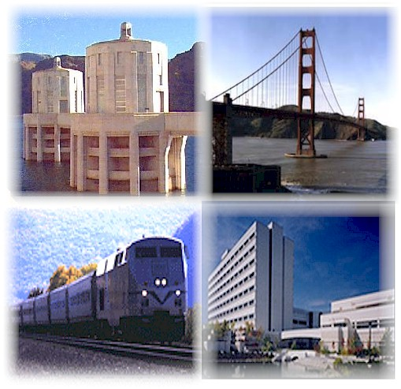
Infrastructure-Paved roads, sidewalks, bridges etc make up what is known as infrastructure.
State has primary responsibility for
Highways
Public welfare
Public health
Cities have primary responsibility for
Police protection
Sanitation
Parks, recreation and libraries
School districts take care of education
Counties do very little

Slide 5
Property Tax
One of the oldest taxes, property taxes are the most important source of revenue for local government, accounting for more than two-thirds of all their tax revenue.
Property taxes are collected on real property and personal property.
Real includes land and buildings
Personal includes such things as stocks and bonds, jewelry, furniture, automobiles, and works of art.
The process of calculating the value of property is called assessment.

Slide 6
Municipal Government
Cities of greater than 5,000 may adopt any form of government, provided it doesn’t conflict with the Texas Constitution. These are home rule cities, and the city adopts a charter under which the city operates. The charter establishes the governing body, organization of agencies and courts, and procedures for elections, annexation and revisions to the charter.
Established by the state, they are entirely dependent on the state government under which they exist. Local governments have no legal independence.

Slide 7
Forms of City Government
Mayor-Council
The most widely used form of municipal government.
Legislative power lies with council, executive with mayor
Mayor is elected city-wide and acts as a CEO, although most Texas mayors are weak
Usually has limited appointment or removal power, limited budgetary authority and shares power with other council members

Slide 8
McKinney City Council
Mayor-Council
The McKinney City Council has seven members. Four Council members are elected to single-member districts, and two Council members and the Mayor are elected at-large.
Council meets at 6:00 p.m. on the first and third Tuesdays of each month at the McKinney City Hall Council Chambers, 222 N. Tennessee.
Current Mayor of McKinney- Brian Lougmiller

Slide 9
Forms of City Government
City Commission
Originally traced to Galveston as a result of the 1900 hurricane
Designed to be more responsive by giving legislative and administrative functions to five city commissioners
Once used in many larger cities, but only a few small cities still use this form
Combination of executive, legislative and administrative was designed to provide efficient services, BUT
No single person is in charge
Minimal policy and budget oversight
Commissioners are elected as policy makers, and usually have little administrative skills

Slide 10
Forms of City Government
Council-Manager
Most popular among home rule cities
Professional city management
Non partisan city elections
Clear distinction between policy making (council) and administration (manager)
Some councils choose their own mayor from within, while other cities have mayor as separate position on the ballot

Slide 11
Forms of City Government
Council
Creates, organizes and structures city departments
Approves budget
Establishes tax rate
Enacts local laws (ordinances)
Hires City Manager

Slide 12
Forms of City Government
Manager
Administers city on a day-to-day basis
Hires assistants and department heads
Supervises employees
Translates policy directives into action
Effectiveness depends on relationship with council, ability to develop support for recommendations, and overall financial and managerial skills

Slide 13
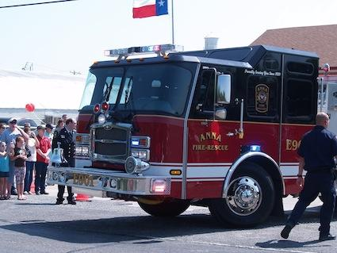
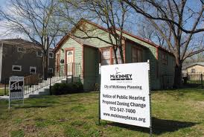
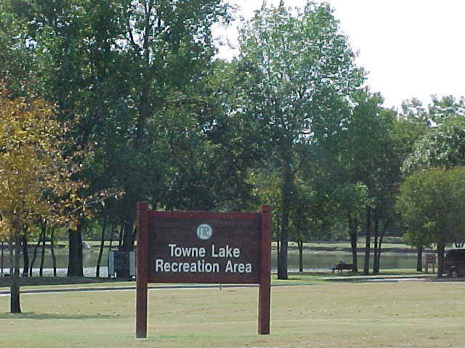
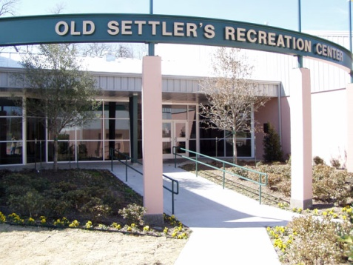
Serving Localities Local Government Services
Education-In many states a large share of local tax revenues goes to pay for public schools.
The School board is responsible for setting school policies, hiring a superintendent, and overseeing day-to-day workings of schools.
Police and Fire Protection
Zoning
Local Governments regulate the way land and buildings may be used.
Water Supply
Sewage and Sanitation
Transportation
Social Services
Recreation and Cultural Activities

Slide 14
County Government
Mexico had large land areas with presidios for military protection
23 were in existence in 1836, and they became the first 23 counties
The Constitution allows the legislature to create or abolish any county at any time, or to alter its size
Any new county is required to meet certain size and proximity to county seat

Slide 15
County Diversity
Largest in population is Harris (3,400,578) and smallest is Loving (67)
Largest in size is Brewster (6,204 square miles) and smallest is Rockwall (147 square miles)
Some counties have county seats “in the middle” while others are located far away from the center

Slide 16
County Structure
Commissioners
Fill midterm vacancies in other county offices
With Judge, approves and controls county budget
Sets salaries and authorizes personnel positions and office expenses
Supervises road and bridge construction in their precinct, unless unit system is adopted

Slide 17
County Structure
County Clerk
Serves as clerk of commissioners court, county courts and in smaller counties, the district court
“dumping ground for miscellaneous functions”
Keeps birth and death records, documents relating to real estate transactions, issues marriage licenses and other licenses required by state (beer and wine, etc.)
Serves as elections administrator (if no other)

Slide 18
County Structure
District Clerk
Keeps custody of district court records
County and District Attorneys
County attorneys prosecute misdemeanors and provide county with legal advice
District attorneys prosecute felonies
Some counties combine prosecutorial functions in a criminal district attorney

Slide 19
County Structure
Tax Assessor-Collector
Ascertains property ownership, determines taxes owed and collects tax
Also provides driver’s license renewal and voter registration
Tax duties are handled by sheriffs in counties with less than 10,000 population unless voters decide differently
Appraisal district determines tax values

Slide 20
County Structure
Sheriffs
Has countywide jurisdiction
Primary law enforcement in smaller counties
Administrative officer for district and county courts
Constables
Assigned to JP precincts
Can patrol, make arrests but primary duty is administrative to JP, helping serve subpoenas and other legal documents

Slide 21
County Structure
Coroner/Medical Examiner
Mostly in larger counties
Appointed
Determines cause of death in unusual cases
JP does coroner duties if none exists
Probation Officer
Handles probationers from the courts, with Chief appointed by District Judges

Slide 22
County Structure
Auditor
Required with population of 10,000 or more
Appointed by District Judges
Reviews all expenditures and income as check and balance to commissioners court and other elected officials
Treasurer
Receives and disburses funds – some counties have abolished office and have auditor handle

