Slide 1


Texas Legislature
Texas State Government
Copyright @ 2011, 2009, 2007 Pearson Education, Inc

Slide 2
Texas Government
Constitution - The Texas constitution establishes the rights, liberties, and responsibilities of citizens. It structures the powers and limitations of the government. It also provides a process by which the constitution can be amended, or changed.
In order to change or amend the Texas Constitution you must have two–thirds of the members of the state house of representatives and senate and a state wide vote.
The Texas Legislature-
One of the three branches of state government
Bicameral - Texas has a bicameral legislature composed of two chambers consisting of a House of Representatives and Senate.
Senate - The Senate has the authority to confirm or reject the governor’s appointments by a two-thirds majority.
Comments:
House - Only the Texas House may initiate legislation to raise taxes, even though both chambers must agree before any tax bill can pass.
The House alone, by majority vote, has the power of impeachment, which is a formal accusation against an executive or judicial officeholder.
Copyright @ 2011, 2009, 2007 Pearson Education, Inc

Slide 3
Texas Legislature
Structure
Session Frequency
Regular Session - The legislature meets in a regular session every other year (biennial), in odd-calendar years with sessions beginning on the second Tuesday in January.
Special Sessions - The Texas Constitution empowers the governor to call special sessions of the legislature, which may last for a maximum of 30 calendar days.
Comments:
Annual legislative sessions are near the top of the list of constitutional reforms because reformers believe that the affairs of state government are too complex to handle in biennial sessions.
Copyright @ 2011, 2009, 2007 Pearson Education, Inc

Slide 4
Texas Legislature
Membership
Term Limits
Term Limits - Term limitation is the movement to restrict the number of terms public officials may serve.
No Texas Limits – Although fifteen states have enacted term limit laws, Texas has not adopted term limits for its legislators.
Comments:
Advocates of term limits believe that they will improve the capacity of the legislature to do its work.
Opponents are convinced that term limits make legislatures less effective.
Copyright @ 2011, 2009, 2007 Pearson Education, Inc

Slide 5
Texas Legislature
Legislative Policymaking
Political Parties
Political Parties – For most of the state’s history, political parties played a relatively small role in legislative policymaking, because nearly every legislator was a Democrat.
Partisan Legislature – The 78th legislature, which met in 2003, marked the beginning of a turn toward a more partisan legislature, especially in the Texas House.
Partisan Drama – Perhaps the biggest legislative drama of the 2009 regular session was the highly partisan battle over voter ID that pitted almost every Democratic legislator against almost every Republican lawmaker.
Comments:
Democratic and Republican legislators disagree on policy issues because they represent different constituencies with different interests.
Copyright @ 2011, 2009, 2007 Pearson Education, Inc

Slide 6
Texas Legislature
Legislative Policymaking
Political Ideology
Political Ideology – Political ideology influences the legislative process in several ways.
Liberalism – Liberalism is the political view that seeks to change the political, economic, or social institutions of society to foster the development and well-being of the individual.
Comments:
Liberals usually favor government regulation and high levels of spending for social programs.
Conservatives generally oppose most government economic regulation and heavy government spending while favoring low taxes and traditional values.
Historically, conservatives have dominated the Texas legislature and legislative policies have reflected their political values.
Conservatism – Conservatism is the political view that seeks to preserve the political, economic, and social institutions of society against abrupt change.
Copyright @ 2011, 2009, 2007 Pearson Education, Inc

Slide 7

Executive Branch
Executive Branch
Chapter Topics
The Governor
The Executive Bureaucracy
Copyright @ 2011, 2009, 2007 Pearson Education, Inc

Slide 8
Executive Branch
The Governor
Chief Executive Officer
Governor - The governor is the chief executive officer of the state with important powers to influence the policymaking process.
Qualifications and Background:
An American citizen
At least thirty years of age
Resident of state for five years preceding election
The qualifications are on the test!
Copyright @ 2011, 2009, 2007 Pearson Education, Inc

Slide 9
Executive Branch
The Governor
Terms of Office
Four Year Term
Increased from two years by a constitutional amendment adopted in 1972.
No limitations on the number of terms of service.
Elections
Elections - Held in even-numbered years (e.g., 2010, 2014) not coinciding with the national presidential elections.
Copyright @ 2011, 2009, 2007 Pearson Education, Inc

Slide 10
Executive Branch
The Governor
Removal
Removal - May be removed through a process of impeachment and removal by the legislature.
Impeachment - The formal process through which the House accuses an executive or judicial branch official of misconduct serious enough to warrant removal from office.
House - Votes to impeach the governor by majority vote.
Senate - Conducts a trial and may vote to remove by a two-thirds margin.
Copyright @ 2011, 2009, 2007 Pearson Education, Inc

Slide 11
Executive Branch
Powers and Responsibilities
Legislative Powers
Of the Governor
Legislative Powers - The Texas Constitution grants the governor authority to act in a broad range of policy areas, but most of the governor’s powers are coupled with limitations.
Condition of the State - The governor delivers the State of the State address at the beginning of each legislative session on the condition of the state.
Veto Legislation - The Texas Constitution permits the governor to veto bills passed by the legislature.
Copyright @ 2011, 2009, 2007 Pearson Education, Inc

Slide 12
Texas Legislature
The Legislative Process
Action by the Governor
Final Passage – Once a bill passes the legislature, it goes to the governor, who has three options.
Take No Action – Take no action on the bill; however, the bill becomes law after ten days if the legislature is in session.
Approve the Legislation – Sign the bill passed by the legislature into law.
Veto – Issue a veto on the entire bill.
Line Item Veto – Exercise line-item veto on appropriation bills. ***This is one power that most Governors have, but the President does not have.
Comments:
Comments:
The Governor has the power to strike out sections or items of an appropriations bill while signing the remainder of the bill into law.
This authority is only applicable in an appropriations bill.
Governor’s veto can be overridden by a two-thirds vote of each chamber if the legislature is still in session.
Copyright @ 2011, 2009, 2007 Pearson Education, Inc

Slide 13

Executive Branch
Powers and Responsibilities
Photo: Erich Schlegel/Dallas Morning News
Since taking office in 2001, Governor Perry has issued 238 vetoes, more vetoes than any governor in the history of the state.
Copyright @ 2011, 2009, 2007 Pearson Education, Inc

Slide 14
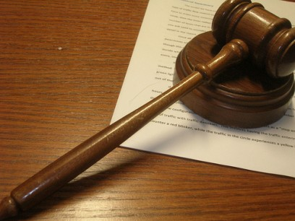
Judicial Branch
Judicial Branch
Copyright @ 2011, 2009, 2007 Pearson Education, Inc

Slide 15
Judicial Branch
Types of Legal Disputes
Criminal Cases
Criminal Case - A criminal case is a legal dispute dealing with an alleged violation of a penal law. In this type of case, the state brings charges against a citizen for violating the law.
Parties in a Criminal Case
Defendant – The criminal defendant is the party charged with the criminal offense.
Prosecutor – The prosecutor is the attorney who tries a criminal case on behalf of the government.
Burden of Proof - In a criminal case the prosecutor has the burden of proof to show the defendant’s guilt “beyond a reasonable doubt.”
Comment: Burden of proof is the legal obligation of one party in a lawsuit to prove its position to a court.
Copyright @ 2011, 2009, 2007 Pearson Education, Inc

Slide 16
Judicial Branch
Types of Legal Disputes
Criminal Cases
Classification of Criminal Offenses - The penal code classifies criminal cases according to their severity.
Misdemeanor - A misdemeanor offense constitutes a relatively minor criminal offense, such as a traffic violation.
Categories - The categories of misdemeanor offenses are Class A, B, or C.
Comment: Severity lies in descending order with regards to jail term and fine, Class A being the most serious.
Copyright @ 2011, 2009, 2007 Pearson Education, Inc

Slide 17
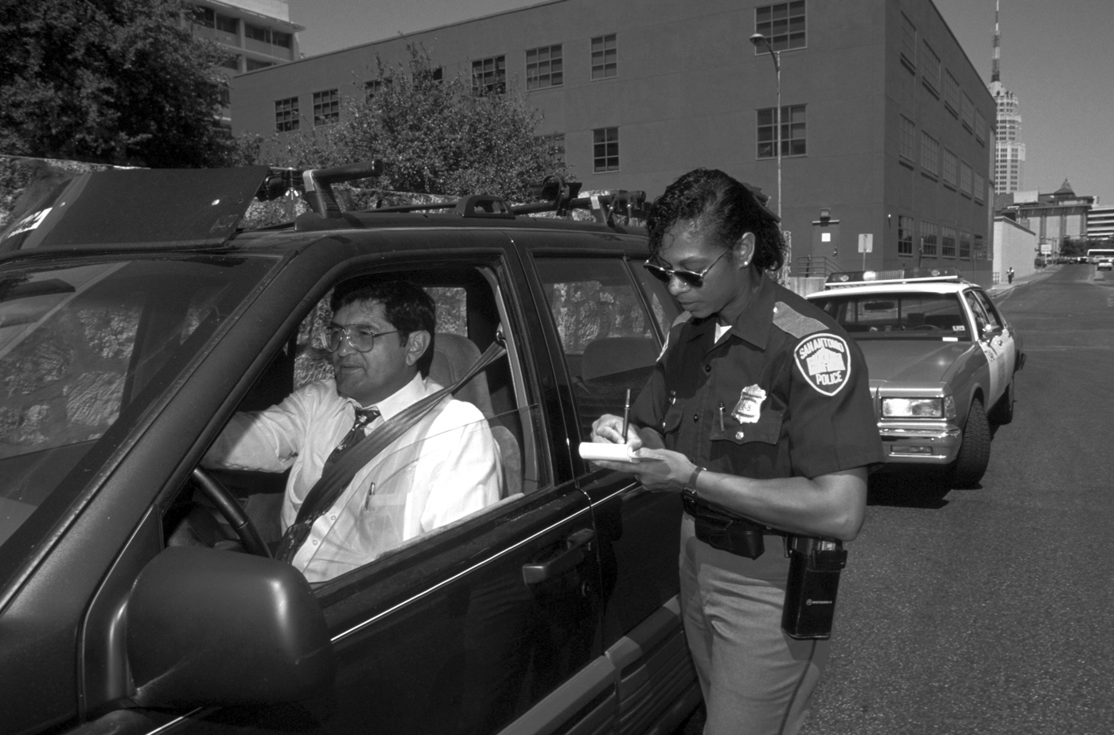
Judicial Branch
Types of Legal Disputes
Photo: Michelle D. Bridwell/PhotoEdit, Inc.
A relatively minor criminal offense, such as a traffic violation, is usually a Class C a misdemeanor.
Copyright @ 2011, 2009, 2007 Pearson Education, Inc

Slide 18
Judicial Branch
Types of Legal Disputes
Criminal Cases
Comment: Severity lies in descending order with regards to jail term and fine (fourth-degree felony is the least serious category of offenses).
Felony - A felony offense constitutes a serious criminal offense, such as murder, sexual assault, or burglary.
Categories - Texas law divides felony offenses into five categories:
Capital felony (death penalty)
First-degree felony
Second-degree felony
Third-degree felony
Fourth-degree (state jail) felony
Copyright @ 2011, 2009, 2007 Pearson Education, Inc

Slide 19
Judicial Branch
Types of Legal Disputes
Civil Disputes
Civil Case - A civil case is a legal dispute concerning a private conflict between two or more parties – individuals, corporations, or government agencies.
Parties in a Civil Case
Plaintiff – Plaintiff is the party initiating the lawsuit.
Defendant – Civil defendant is the responding party.
Comment: In a civil case the plaintiff has the burden of proof to prove the case “by a preponderance of the evidence.”
Copyright @ 2011, 2009, 2007 Pearson Education, Inc

Slide 20
Judicial Branch
Types of Legal Disputes
Civil Disputes
Civil Case - A civil case is a legal dispute concerning a private conflict between two or more parties – individuals, corporations, or government.
Types of Civil Disputes:
Property Case - Property case is a civil suit over the ownership of real estate or personal possessions such as land, jewelry, or an automobile.
Probate Case - Probate case is a civil suit dealing with the disposition of the property of a deceased individual.
Domestic-Relations Case - Domestic-relations case is a civil suit based on the law involving the relationships between husband and wife, and between parents and children.
Contract Case - Contract case is a civil suit dealing with disputes over written or implied legal agreements.
Tort Case - Tort case is a civil suit involving personal injury or damage to property.
Adversary Proceeding - The judicial proceeding is generally an adversary proceeding, which is a legal procedure in which each side presents evidence and arguments to bolster its position while rebutting evidence submitted by the other side.
Copyright @ 2011, 2009, 2007 Pearson Education, Inc

Slide 21
Judicial Branch
Court Procedures
Negotiation and Compromise
Negotiation and Compromise - In practice most legal disputes are settled not by trials but through a process of negotiation and compromise between the parties.
Civil Cases - In civil cases the litigants may decide to resolve the dispute by settling out of court rather than going through the trial process.
Criminal Cases - In criminal cases the defendant and the prosecutor may resolve the case through a plea bargain, which is a procedure in which the defendant agrees to plead guilty in order to receive punishment less than the maximum for the offense.
Copyright @ 2011, 2009, 2007 Pearson Education, Inc

Slide 22
Judicial Branch
Court Procedures
Trials and Appeals
Trials and Appeals - Judicial proceedings are basically divided into trials and appeals.
Trials:
Procedures - Formal examination of a civil or criminal action in accordance with the law before a single judge who has jurisdiction to hear the dispute.
Involves - Attorneys, witnesses, testimony, evidence, judges, and, occasionally, juries.
Process - In general, the trial court is concerned with questions of facts and the law as it applies to those facts.
Verdict - The verdict determines in a civil case which party prevails in the lawsuit and in a criminal case whether the defendant is guilty or not guilty as charged.
Copyright @ 2011, 2009, 2007 Pearson Education, Inc

Slide 23
Judicial Branch
Court Procedures
Trials and Appeals
Trials and Appeals - Judicial proceedings are basically divided into trials and appeals.
Appeals:
An appeal is the taking of a case from a lower court to a higher court by the losing party in a lower court decision.
As grounds for appeal in civil cases, the losing party may allege that the lower court failed to follow proper procedures or incorrectly applied the law.
As grounds for appeal in criminal cases, the criminal defendant contends that the trial court committed reversible error, which is a mistake committed by a trial court that is serious enough to warrant a new trial because the mistake could have affected the outcome of the original trial.
Appeals: (Continued)
Involve attorneys, written and oral arguments, and written court records.
In general, the appellate court is concerned with issues of law and procedure.
The ruling of court may uphold, reverse, or modify the lower court decision.
Copyright @ 2011, 2009, 2007 Pearson Education, Inc

Slide 24

Judicial Branch
The Texas Court System
Court System
Levels - The Texas court system has three levels:
Local Courts
District Courts
Appellate Courts
Copyright @ 2011, 2009, 2007 Pearson Education, Inc

Slide 25
Judicial Branch
The Texas Court System
Municipal Courts
Municipal Courts - Created by the Texas legislature in every incorporated city.
Operate in 913 cities staffed by 1,458 judges.
Exercise criminal jurisdiction involving Class C misdemeanor offenses.
Exclusive jurisdiction involving violations of city ordinances, which are laws enacted by the governing body of a municipality.
Generally function as traffic courts (traffic cases account for more than 80 percent of the workload of municipal courts).
Perform magistrate duties.
Copyright @ 2011, 2009, 2007 Pearson Education, Inc

Slide 26
Judicial Branch
The Texas Court System
Justice of Peace (JP) Courts
Justice of Peace (JP) Courts - The Texas constitution requires each county to operate at least one JP court and allows larger counties to have as many as 16.
Justice of Peace (JP) Courts
In 2009, 822 JP courts operated statewide.
Exercise criminal jurisdiction involving Class C misdemeanor offenses.
Exercise civil jurisdiction handling civil cases involving amounts of money of no more than $10,000.
Function as small claims courts and evictions.
Perform magistrate duties.
Copyright @ 2011, 2009, 2007 Pearson Education, Inc

Slide 27
Judicial Branch
The Texas Court System
County Courts
Constitutional County Courts - Created by Texas Constitution in each of the state’s 254 counties.
Constitutional County Courts
Exercise criminal jurisdiction involving Class A and B misdemeanor offenses.
Exercise civil jurisdiction handling civil cases involving amounts of money between $200 and $5,000.
Handle appeals de novo (new trials) from Justice of Peace courts or municipal courts.
Copyright @ 2011, 2009, 2007 Pearson Education, Inc

Slide 28
Judicial Branch
The Texas Court System
County Courts
Statutory County Courts - The Texas legislature has created 218 additional county courts known as statutory county courts (because they are established by statute) and 17 statutory probate courts to supplement the constitutional county courts.
Statutory County Courts
Established by the Texas legislature.
Exercise criminal jurisdiction involving Class A and B misdemeanor offenses.
Exercise civil jurisdiction handling civil cases involving amounts of money up to $100,000.
Handle Class C misdemeanor appeals from JP or municipal courts and civil case appeals from JP courts.
Statutory Probate Courts
Established by the Texas legislature to supplement constitutional county courts in primarily urban areas where caseloads are overwhelming.
Copyright @ 2011, 2009, 2007 Pearson Education, Inc

Slide 29
Judicial Branch
The Texas Court System
District Courts
District Courts - Texas has 449 district courts that serve as the basic trial courts of the state.
District Courts
Each court serves a specific geographic area, which may encompass several counties in the rural areas.
Basic trial courts of the state.
Exercise criminal jurisdiction involving felony offenses.
Exercise civil jurisdiction handling civil cases involving amounts of money of $200 or more.
Copyright @ 2011, 2009, 2007 Pearson Education, Inc

Slide 30
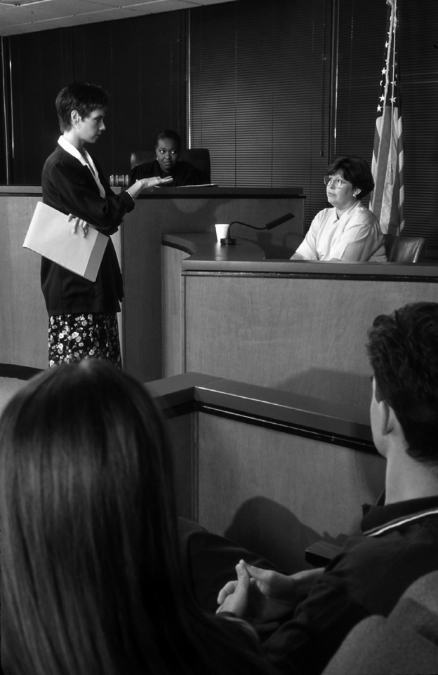
Judicial Branch
The Texas Court System
Burden of Proof :
The burden of proof in civil cases is on the plaintiff, but it is not as heavy as it is in criminal disputes.
With the exception of lawsuits filed to terminate parental rights, the plaintiff is only required to prove the case “by a preponderance of the evidence.”
Photo: Bob Daemmrich/The Image Works
The plaintiff has the burden of proof in a civil trial.
Copyright @ 2011, 2009, 2007 Pearson Education, Inc

Slide 31
Judicial Branch
The Texas Court System
Appellate Courts
Appellate Courts - Handle appeals from the lower trial courts.
Appellate Courts
Review the trial court record, schedule oral arguments, study legal briefs, and render a decision/opinion
The court may affirm the lower court decision, reverse it, modify it, or affirm part of the lower court ruling while reversing or modifying the rest.
Copyright @ 2011, 2009, 2007 Pearson Education, Inc

Slide 32
Judicial Branch
The Texas Court System
Appellate Court Opinions
Opinions - Appellate Courts may issue three types of opinions.
Majority Opinion - The official written statement of the court that explains and justifies its ruling and serves as a guideline for lower courts.
Dissenting Opinion – A written judicial statement that disagrees with the decision of the court’s majority.
Concurring Opinion – A written judicial statement that agrees with the court’s ruling but disagrees with the reasoning of the majority.
Copyright @ 2011, 2009, 2007 Pearson Education, Inc

Slide 33
Judicial Branch
The Texas Court System
Types of Appellate Courts
Types - Texas has three types of appellate courts.
Courts of Appeals
Texas Court of Criminal Appeals
Texas Supreme Court
Comments:
Texas is one of two states with two supreme courts; the Texas Supreme Court for civil disputes and the Texas Court of Criminal Appeals for criminal matters.
Oklahoma is the other state with two supreme courts.
Copyright @ 2011, 2009, 2007 Pearson Education, Inc

Slide 34
Judicial Branch
The Texas Court System
Courts of Appeals
Courts of Appeals
Fourteen courts of appeals, each serving a specific geographic area.
Hear both civil and criminal appeals from the district and county courts, except death penalty appeals, which go directly to the Texas Court of Criminal Appeals.
Altogether, 80 justices staff the 14 courts of appeal with the number of justices in each court varying from 3 to 13, depending on workload.
Copyright @ 2011, 2009, 2007 Pearson Education, Inc

Slide 35
Judicial Branch
The Texas Court System
Texas Court of Criminal Appeals
Texas Court of Criminal Appeals
Highest (supreme) appellate court for all criminal cases in the state.
Considers death penalty cases appealed directly from the district court.
Consists of one presiding justice and eight additional judges.
Decisions from this court may be appealed to the U.S. Supreme Court when they involve matters of federal law or the U.S. Constitution.
Copyright @ 2011, 2009, 2007 Pearson Education, Inc

Slide 36
Judicial Branch
The Texas Court System
Texas Supreme Court
Texas Supreme Court
Highest (supreme) appellate court for all civil cases.
Consists of one chief justice and eight associate justices. These Justices are elected for six year terms.
Decisions from this court may be appealed to U.S. Supreme Court when they involve matters of federal law or the U.S. Constitution.
Administers the judicial branch of state government.
Copyright @ 2011, 2009, 2007 Pearson Education, Inc

Slide 37
Judicial Branch
Texas Judges
Table 10.1 Texas Judges
Copyright @ 2011, 2009, 2007 Pearson Education, Inc

Slide 38
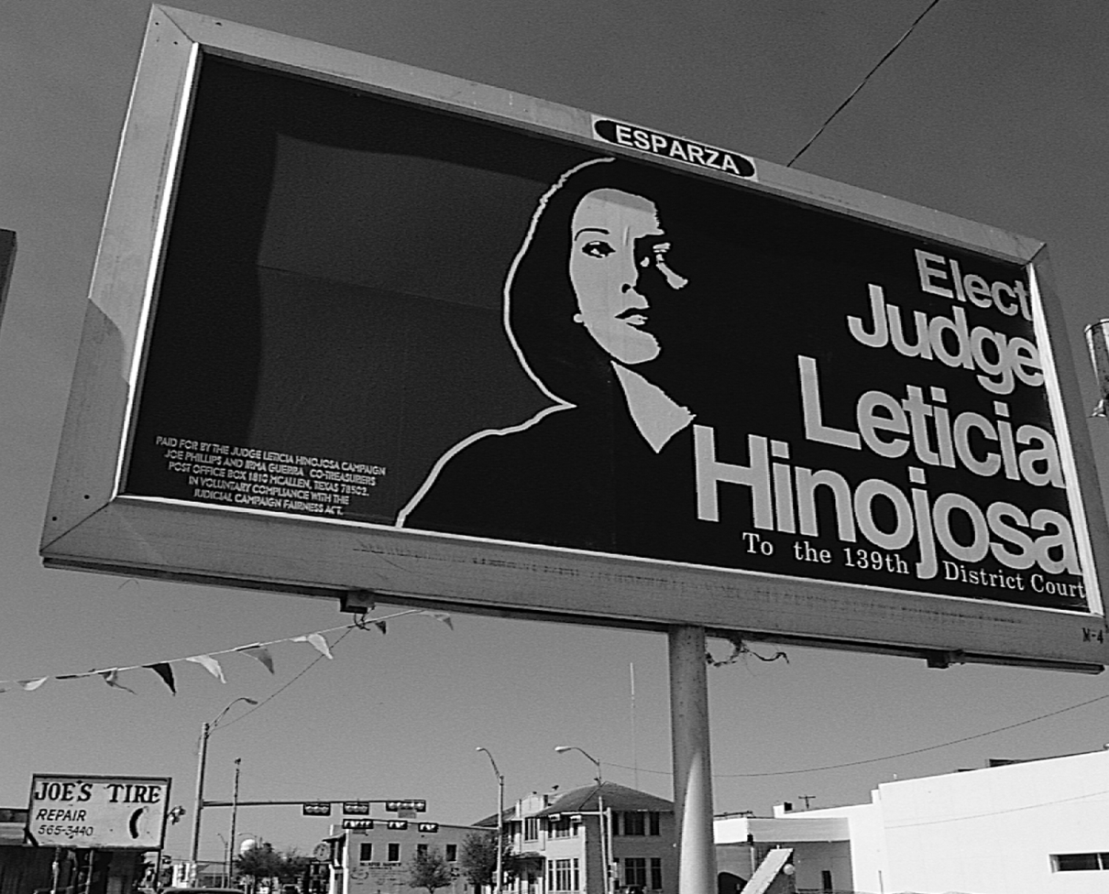
Judicial Branch
Judicial Selection
Judicial Selection
Judicial Selection - Except for some municipal judges who are appointed, Texas judges are chosen by partisan election, which is a contest in which both the names of the candidates and their party affiliations appear on the ballot. (Republican or Democrat)
Texas Judges
Texas and seven other states elect judges on the partisan ballot.
Texas judges campaign for election just like members of the legislative and executive branches of government.
Photo: Bob Daemmrich/The Image Works
Copyright @ 2011, 2009, 2007 Pearson Education, Inc

Slide 39
Judicial Branch
Judicial Selection
Is Justice for Sale in Texas?
Partisan Elections - Critics of the judicial selection system based upon partisan elections believe that money plays too prominent a role in the process.
Partisan Elections
Successful candidates for the Texas Supreme Court must raise and spend at least $800,000.
Candidates for district judgeships may raise and spend more than $30,000 on their campaigns.
Copyright @ 2011, 2009, 2007 Pearson Education, Inc

Slide 40
Judicial Branch
Judicial Selection
Partisan Politics vs. Judicial Impartiality
Partisan Politics - Is partisan politics incompatible with judicial impartiality?
Partisan Elections - Can a Republican defendant receive a fair trial from a Democratic judge or vice versa?
As long as Texas elects judges on a partisan ballot, at least some individuals will believe that party politics will determine the outcomes rather than the law and the constitution.
Copyright @ 2011, 2009, 2007 Pearson Education, Inc

Slide 41
Judicial Branch
Judicial Selection
Judicial Retirement and Removal
Judicial Departure - Departure from the bench can be due to death, retirement, loss of reelection or removal by competent authority.
Removal
Removal from office for incompetence or unethical conduct.
Disciplinary actions against a judge may entail an admonition, warning, reprimand, and recommendation to remove from office.
Impeachment by majority vote in the state House and removal by a two-thirds vote of the Senate.
Copyright @ 2011, 2009, 2007 Pearson Education, Inc

Slide 42

Voting in Texas
Voters in Texas must meet certain qualifications:
Citizen or resident of Texas
At least 18 years old on the day of the election
A resident of the voting precinct on election day.
Registered as a voter for at least 30 days before the election
A resident of the state and county 30 days before the election.

Slide 43
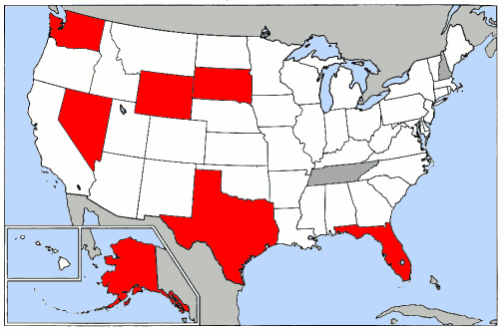
Financing and Budget
Sources of state revenue
Texas is one of only seven states that does not have an income tax.
The state sales tax is one of the two main sources of government revenue. Other taxes, on items such as gasoline, cars, trucks, and manufactured housing also raise money. In addition corporations pay a franchise tax for the privilege of doing business in Texas.
The most important nontax sources are grants from the federal government, fees, fines, permits, and money earned from public lands.

